Slide 1

Notes:
Welcome, everyone. Today, we explore a landscape shaped by three intersecting crises: the ideological capture of our foundational institutions, the current speculative hyperbole surrounding Artificial Intelligence, and the essential path forward for American innovation and physical engineering.
This discussion is distilled directly from the experiences and perspectives of Ben Slivka—a Silicon Valley veteran, former Microsoft lead who headed the development of Internet Explorer 1 through 4, and a trustee who served for two decades on the governing board of Northwestern University[cite: 1, 2].
When we step back and analyze where we stand today, we observe a striking paradox:
On one hand, the United States continues to lead global innovation, commanding over a quarter of global GDP and pioneering breakthroughs from commercial spaceflight to advanced semiconductor design.
On the other hand, our legacy institutions—especially elite higher education and corporate boards—have increasingly succumbed to ideological conformity, administrative bloat, and institutional cowardice[cite: 1, 2].
As Ben Slivka’s career demonstrates, progress is not driven by top-down bureaucratic consensus or utopian social engineering[cite: 1, 2]. Real progress comes from respecting fundamental constraints: whether those are the laws of physics and thermodynamics in physical engineering, or the 300,000-year-old biological and evolutionary realities of human nature.
Over the course of this presentation, we will walk through 13 slides examining:
How elite universities surrendered their core mission of seeking truth in favor of identity metrics and administrative self-preservation[cite: 1, 2].
Why human evolutionary biology drives institutional conformity and how "the cowardice loop" functions.
The structural failures of the industrial K-12 education model compared to alternative market-driven models.
Historical lessons from the 1995 Web-versus-Windows platform wars and how they map to today's AI landscape.
The mathematical realities of Large Language Models versus biological brain architecture.
The physical bottlenecks of energy, launch infrastructure, and economic growth.
Let us begin by laying out the central philosophical framework: The Constrained Vision versus the Utopian Illusion.
Ben Slivka Predicted the Internet Era. He Doesn't Buy the Hype About AI.
https://www.youtube.com/watch?v=xghaeBHamYs

Slide 2
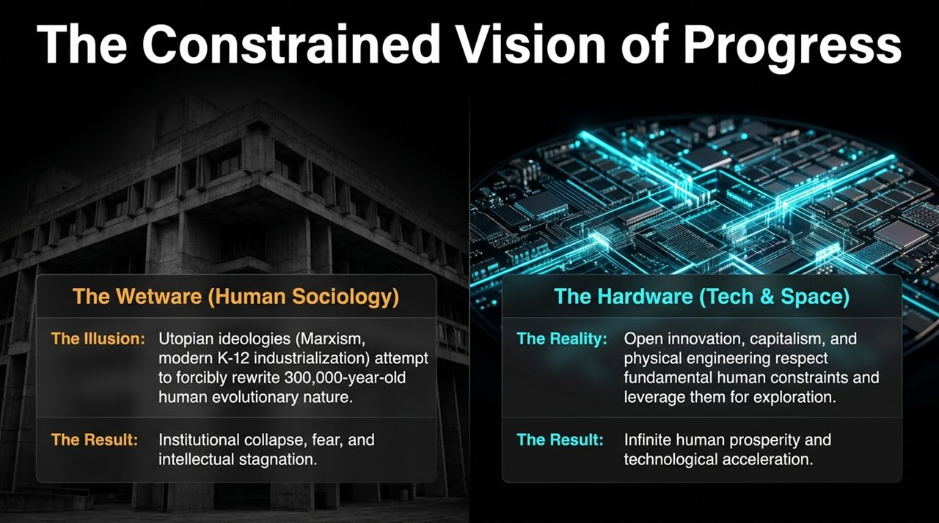
Notes:
To understand the current crisis in American leadership and innovation, we must contrast two fundamentally opposed worldviews: what economist Thomas Sowell termed the "Constrained Vision" versus the "Unconstrained or Utopian Vision," framed here across Human Sociology (Wetware) and Technology (Hardware).
1. The Wetware (Human Sociology): The Illusion vs. Reality
The Illusion: For the past several decades, dominant social and educational ideologies—ranging from historical Marxism to modern administrative K-12 industrialization and DEI mandates—have operated on an unconstrained assumption[cite: 1, 2]. They assume human nature is an infinitely malleable blank slate that can be forcibly re-engineered through top-down policy, language regulation, and social coercion[cite: 1, 2].
The Reality: Human biological hardware is not a blank slate. Our brain structure and social instincts evolved over 300,000 years in small tribal environments where group cohesion and conformity meant immediate survival. You cannot rewrite 300 millennia of evolutionary biology with bureaucratic mandates.
The Result: When institutions try to force reality to fit utopian theory, the result is predictable: institutional collapse, ambient fear, self-censorship, and intellectual stagnation[cite: 1, 2].
2. The Hardware (Tech & Space): Open Innovation vs. Physical Realism
Conversely, consider where genuine progress actually happens: in physical engineering, capitalism, open-source software, and aerospace.
The Engineering Paradigm: An engineer designing a rocket or a semiconductor wafer cannot bribe or guilt-trip the laws of physics. Gravity, thermal dissipation, power draw, and bandwidth limits respect no ideology.
Leveraging Constraints: Capitalism and open innovation succeed precisely because they accept human self-interest and physical laws as fixed constraints. Rather than trying to eliminate human nature, open systems align incentives and leverage constraints to foster real-world problem solving.
The Result: The result of respecting constraints is infinite human prosperity, technological acceleration, drastically reduced poverty, and expansion into new physical frontiers.
Key Takeaway:
When leadership shifts focus from solving physical constraints to enforcing social illusions, institutions decay. Next, we will examine how this decay plays out inside top-tier university systems through the mechanism of The Ideological Capture Loop[cite: 1, 2].

Slide 3
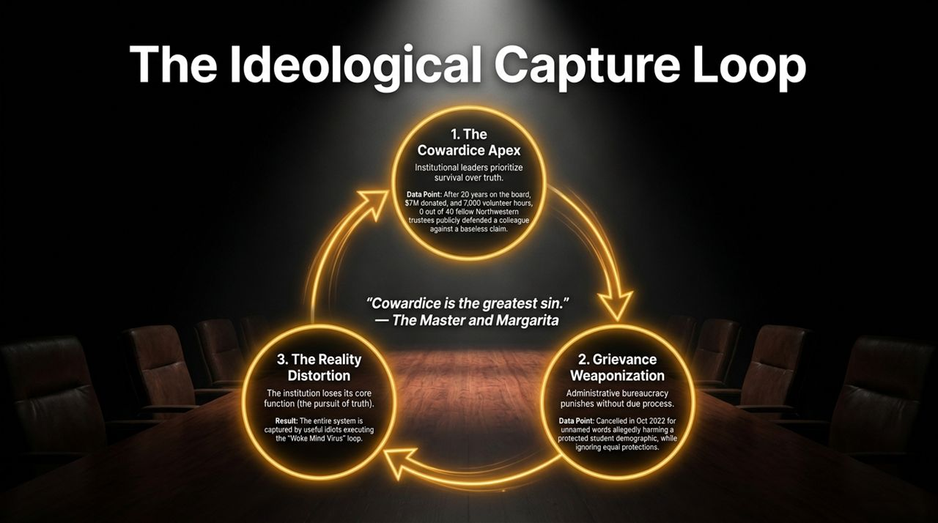
Notes:
Slide 3 details the structural mechanics of how elite legacy institutions rot from within. This model is directly informed by Ben Slivka’s firsthand experience as a 20-year member of the Board of Trustees at Northwestern University[cite: 1, 2].
The loop operates through a three-stage cycle:
[1. Cowardice Apex] ──> [2. Grievance Weaponization] ──> [3. Reality Distortion] ──>
Stage 1: The Cowardice Apex
Institutional leaders—presidents, deans, and trustees—prioritize short-term reputational risk management and personal survival over truth and due process[cite: 1, 2].
Empirical Data Point: Consider Ben Slivka’s own experience[cite: 1, 2]. After spending 20 years on the Northwestern Board of Trustees, contributing over $7,000 volunteer hours, donating $7 million, and having a building named in his family's honor, he attended a campus event in October 2022[cite: 1, 2].
A month later, he received an administrative notice from an athletic department DEI officer alleging unspecific "sexist or racist remarks" to student-athletes, barring him from contact with student-athletes without hearing, specification of the alleged words, or due process[cite: 2].
When Slivka reached out to 40 trustee colleagues with whom he had served for decades, zero out of 40 were willing to publicly defend due process or question the administrative overreach[cite: 1, 2]. As Solzhenitsyn and Bulgakov noted in The Master and Margarita: "Cowardice is the most terrible vice."
Stage 2: Grievance Weaponization
Once leadership signals that it will cave to ideological pressure to avoid conflict, an un-elected administrative bureaucracy steps in[cite: 1, 2]. DEI officers and middle-tier administrators weaponize vague complaints to bypass traditional governance, faculty oversight, and fundamental legal standards of due process[cite: 1, 2].
The absurdity of Slivka’s cancellation was stark: the restriction applied solely to student-athletes (implying a 300-pound lineman needed protection from spoken words), while a humanities major was deemed capable of handling open discourse[cite: 2]. The policy was not about protecting students; it was about demonstrating administrative power[cite: 1, 2].
Stage 3: The Reality Distortion
When fear governs the apex and administrative power is weaponized, the institution loses its primary raison d'être: the uninhibited pursuit of truth[cite: 1, 2].
Faculty and students begin operating under pervasive fear[cite: 2]. Ideological zealots and opportunists occupy the silence left by reasonable people.
The institution becomes fully captured by an ideological loop where self-censorship is mandatory, merit is degraded, and institutional prestige is traded away for administrative compliance[cite: 1, 2].

Slide 4
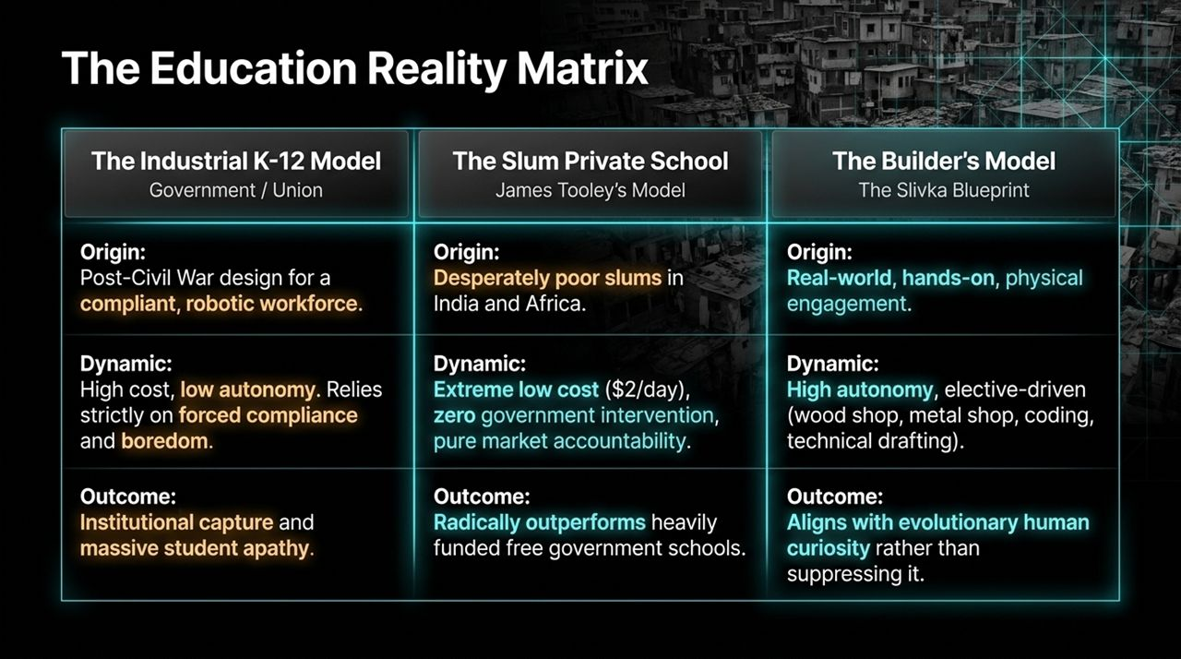
Notes:
Having seen how elite higher education collapses into ideological compliance, let us trace this problem back to its root: the primary and secondary education pipeline. Slide 4 contrasts three distinct models of education: The Industrial K-12 Model, The Slum Private School Model, and The Builder’s Model.
Feature The Industrial K-12 Model The Slum Private School (Tooley) The Builder's Model (Slivka)
Origin Post-Civil War Prussian model built for factory compliance[cite: 1, 2]
Low-income slums of India, Africa, & LATAM
Early 20th-century hands-on technical training
Cost & Autonomy High cost/student; Low teacher & student autonomy
Extremely low cost (~$2/day); High operational freedom
Flexible, elective-heavy, capital efficient
Primary Dynamic Top-down mandate, union bloat, forced compliance
Pure market accountability to parent community
Physical mastery, shop, coding, real projects
Outcome Institutional capture, apathy, skill stagnation
Outperforms state schools at a fraction of cost
High agency, practical problem solvers
1. The Industrial K-12 Model (Government / Union Monopolies)
Designed in the late 19th century following the Prussian industrial system, this model was designed to produce compliant factory workers capable of sitting quietly for 8 hours[cite: 1, 2].
Today, despite skyrocketing per-pupil spending, reading and math proficiency continue to drop while administrative overhead expands. It relies on forced compliance and standard testing, breeding apathy and intellectual passivity.
2. James Tooley’s Slum Private School Model
Educational researcher James Tooley documented a fascinating phenomenon across the poorest slums of Hyderabad, Lagos, and Kibera.
Without government subsidies, impoverished parents spend ~$2 a day out of pocket to send their children to unaccredited, micro-private schools.
The Result: Because these schools operate on pure market accountability—if teachers don't teach, parents walk—these low-cost private slum schools consistently outperform heavily funded, free government schools in literacy and numeracy.
3. The Builder’s Blueprint (Slivka Model)
Ben Slivka advocates returning to hands-on, elective-driven physical engagement.
Children do not learn by absorbing abstract doctrine; they learn by building. Wood shop, metal working, automotive repair, drafting, and writing code engage biological curiosity.
Education must align with evolutionary human nature rather than attempting to suppress it through bureaucratic standardization.

Slide 5
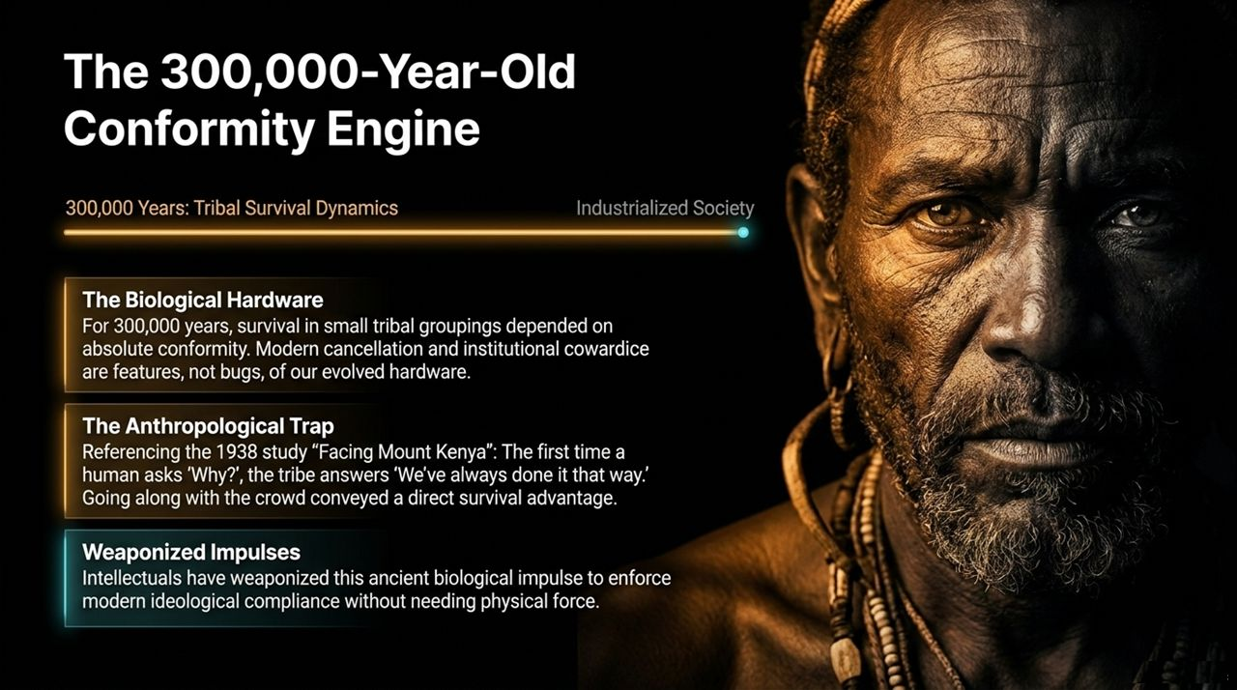
Notes:
Why is ideological capture so effective? Why do intelligent adults—university presidents, corporate executives, scientists—surrender so quickly to absurd social dogmas[cite: 1, 2]?
Slide 5 explains the anthropological and biological mechanics behind modern cancellation.
[300k Years of Tribal Survival] ──> [Anthropological "We've Always Done It"] ──> [Modern Weaponization]
1. The Biological Hardware (300,000 Years of Evolution)
For 99% of human history, Homo sapiens survived in small hunter-gatherer bands of 50 to 150 individuals.
In a paleolithic environment, being ostracized or banished from the tribe meant guaranteed death. Survival required acute sensitivity to group consensus and immediate compliance with social norms.
Therefore, the human brain evolved deep neurological distress signals around social rejection. Modern cancellation, call-out culture, and institutional cowardice are not glitches in our system; they are features of our ancient biological hardware.
2. The Anthropological Trap
Slivka points to Jomo Kenyatta's landmark 1938 anthropological study Facing Mount Kenya.
Kenyatta observed that the moment an individual child or reformer asks "Why do we perform this ritual?", the tribe responds: "Because we have always done it this way."
Questioning tribal dogma threatened group unity and exposed the band to external threats. Going along with the crowd conveyed a direct, immediate biological survival advantage.
3. Weaponized Impulses in Industrial Society
In the modern era, political ideologues and bureaucratic activists have learned to hack this ancient biological software.
By threatening reputational damage, social isolation, or professional blacklisting, small organized minorities can force an entire institution to conform[cite: 1, 2]. Physical force is no longer necessary; threatening social death is sufficient to ensure complete compliance from educated elites[cite: 1, 2].

Slide 6
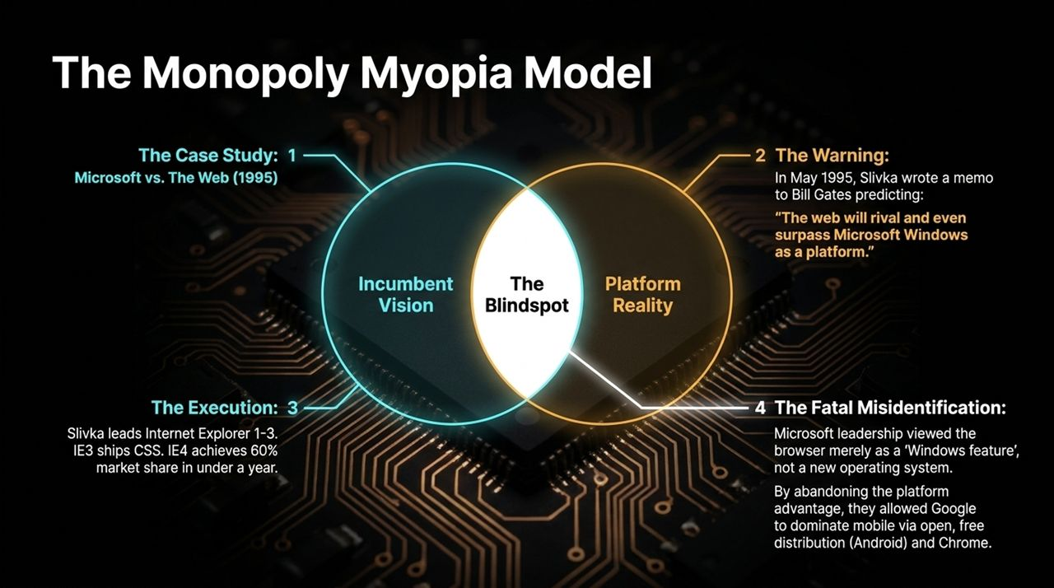
Notes:
Shifting from sociology to technology, Slide 6 presents a historical case study in competitive blindspots: Microsoft vs. The Web in 1995[cite: 1, 2]. This case study offers crucial lessons for understanding current technology monopolies and platform shifts.
[May 1995: Slivka Memo to Gates] ──> [IE1-4 Execution (60% Share)] ──> [Incumbent Misidentification] ──> [Platform Shift Lost]
1. The Warning (May 1995)
In May 1995, Ben Slivka authored a famous internal memorandum to Bill Gates and Microsoft executive leadership titled "The Web is the Next Platform."[cite: 1, 2]
Slivka predicted that open web protocols and browser interfaces would eventually rival—and surpass—Windows as the primary computing platform for application development[cite: 1, 2].
2. The Execution (Internet Explorer 1 through 4)
Slivka was tasked with leading the engineering effort for Internet Explorer[cite: 1, 2]. His team executed one of the fastest product rollouts in software history:
IE1 and IE2 established basic web functionality.
IE3 introduced Cascading Style Sheets (CSS) and developer tools.
IE4 integrated browser capabilities deeply into the user experience, capturing over 60% market share within a single year and effectively neutralizing Netscape.
3. The Incumbent's Fatal Blindspot: "Feature vs. Platform"
Despite IE's massive market success, Microsoft's senior executive leadership suffered from Monopoly Myopia.
They viewed the Web browser merely as a value-add "feature of Windows"—a tool designed to lock users into the Windows desktop ecosystem.
They failed to recognize that the browser was a brand-new, cross-platform runtime environment that rendered the underlying desktop operating system irrelevant.
4. The Long-Term Consequence
Because Microsoft focused on defending its legacy desktop OS monopoly rather than leaning into open web platforms, it lost the next major computing shift.
Google subsequently leveraged open protocols, browser search integration, and an open-source mobile OS (Android) to dominate the modern web and mobile ecosystems.
Core Takeaway:
Monopolies always believe their position is permanent. They routinely mistake existential platform shifts for secondary features of their existing core products.

Slide 7
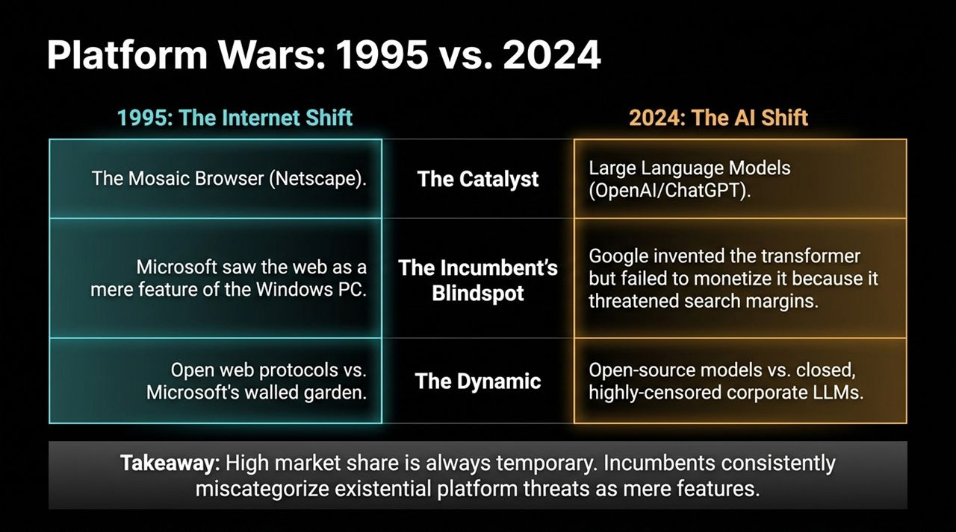
Notes:
Slide 7 maps the structural dynamics of the 1995 Internet explosion onto today's Artificial Intelligence boom. The pattern of incumbent blindspots and platform transitions is repeating almost identically.
1995: Web Protocols (Mosaic/Netscape) ──> Microsoft misidentified Web as Windows feature.
2024: LLMs / GenAI (OpenAI/ChatGPT) ──> Google misidentified Transformers; defended Search margins.
Comparison Breakdown:
Dimension 1995: The Internet Shift 2024: The AI Shift
The Catalyst NCSA Mosaic / Netscape Navigator
OpenAI / ChatGPT / Transformer Architecture
The Incumbent Microsoft (Windows Monopoly)
Google (Search & Ad Monopoly)
Incumbent Blindspot Viewed the browser as a desktop feature.
Invented Transformers (2017) but delayed release to protect high-margin search ads.
The Dynamic Walled Gardens (MSN) vs. Open Web Protocols
Closed, heavily censored corporate LLMs vs. Open-Source Models (Llama, Mistral)
Market Reality Desktop OS lost strategic leverage to the Web.
Traditional ad-supported Search engines risk disintermediation by direct synthesis.
Key Insights:
The Innovator's Dilemma in Action: Google researchers published the foundational Attention Is All You Need paper in 2017. Yet, Google sat on the technology for five years because deploying conversational synthesis posed an immediate threat to their 90%+ gross margin ad-search monetization model.
Open vs. Closed Ecosystems: Just as open HTML/HTTP protocols defeated proprietary walled gardens like early MSN or AOL, today's open-source model ecosystem is rapidly closing the gap with closed, heavily moderated corporate API endpoints.
High Market Share is Always Temporary: Dominance built on yesterday's platform architecture can evaporate in a few years if an incumbent treats a fundamental paradigm shift as a mere product add-on.

Slide 8
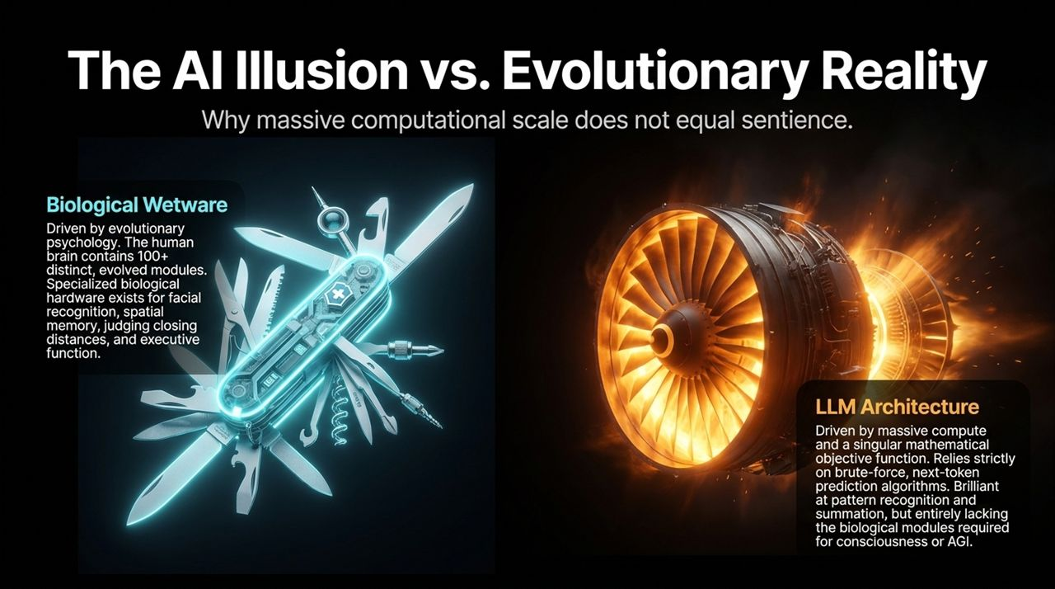
Notes:
Slide 8 addresses the current hype around Artificial General Intelligence (AGI). Silicon Valley luminary Ben Slivka pushes back strongly against the popular narrative that scaling compute and parameter counts will automatically result in machine consciousness or human-level reasoning[cite: 1, 2].
[Biological Wetware] ──> 100+ Evolved, Power-Efficient Modules (20 Watts)
VS
[LLM Architecture] ──> Brute-Force Next-Token Matrix Math (Megawatts)
1. Biological Wetware (The Evolved Human Brain)
The human brain operates on approximately 20 watts of power—roughly the energy required to light a faint bulb.
It is not a uniform matrix multiplier. It is an intricately structured system comprised of over 100 distinct, specialized evolutionary modules.
We have specialized biological hardware for spatial orientation, real-time motor control, judging closing distances, facial recognition, theory of mind, emotional valuation, and executive planning.
These modules evolved over hundreds of millions of years to interact with a physical environment under strict energy constraints.
2. LLM Architecture (Transformer Models)
Large Language Models operate on a fundamentally different, non-biological mechanism: brute-force matrix multiplication optimized for a single mathematical objective function—predicting the statistically most likely next token in a text sequence.
While LLMs display impressive abilities in pattern matching, translation, code synthesis, and text summarization, they possess no internal world model, no consciousness, no agency, and no specialized cognitive modules.
To produce output, an LLM cluster requires megawatts of electricity, massive cooling infrastructure, and gigawatts of data center capacity.
3. The AGI Fallacy
Scaling up matrix multiplication on static text datasets does not create biological consciousness.
Calling next-token statistical prediction "AGI" confuses syntax with semantics and scale with intelligence. Real intelligence is grounded in physical interaction with the world and specialized modular architecture.

Slide 9

Notes:
If AI compute and industrial expansion are to continue, we must ground our ambitions in Energy Realism. Slide 9 shifts our focus to the physical bottlenecks facing Western civilization: power generation, grid capacity, and the ability to execute heavy civil engineering.
[China CO2 & Generation Dominance] ──> [US Self-Inflicted Permitting Paralysis] ──> [Physical Buildout Required]
1. The Geopolitical Energy Reality
CO2 Output: China surpassed the United States in total carbon output back in 2006.
Electricity Generation: China crossed the United States in total electrical power generation in 2011. Today, China generates more than double the electricity of the United States, aggressively building nuclear reactors, coal plants, solar arrays, and hydroelectric dams simultaneously.
2. The Flawed Anti-AI Environmental Narrative
A popular narrative claims that AI data centers are uniquely "destroying the planet" by consuming excessive power and water.
This framing misses the broader picture. Power consumption is the fundamental metric of technological civilization. The issue is not that AI uses too much power; the issue is that America has spent four decades crippling its ability to build new power infrastructure.
3. Self-Inflicted Infrastructure Paralysis
Through endless environmental litigation, NEPA reviews, permitting delays, and regulatory paralysis, the U.S. has effectively banned the construction of modern hydroelectric dams, baseline nuclear fission reactors, and interstate natural gas pipelines.
We have traded physical engineering mastery for administrative process and regulatory doomerism.
Core Message:
You cannot code your way out of an energy shortage. Virtual progress requires physical power. If the United States intends to maintain its technological leadership, it must rediscover how to build heavy energy infrastructure in the real world.

Slide 10
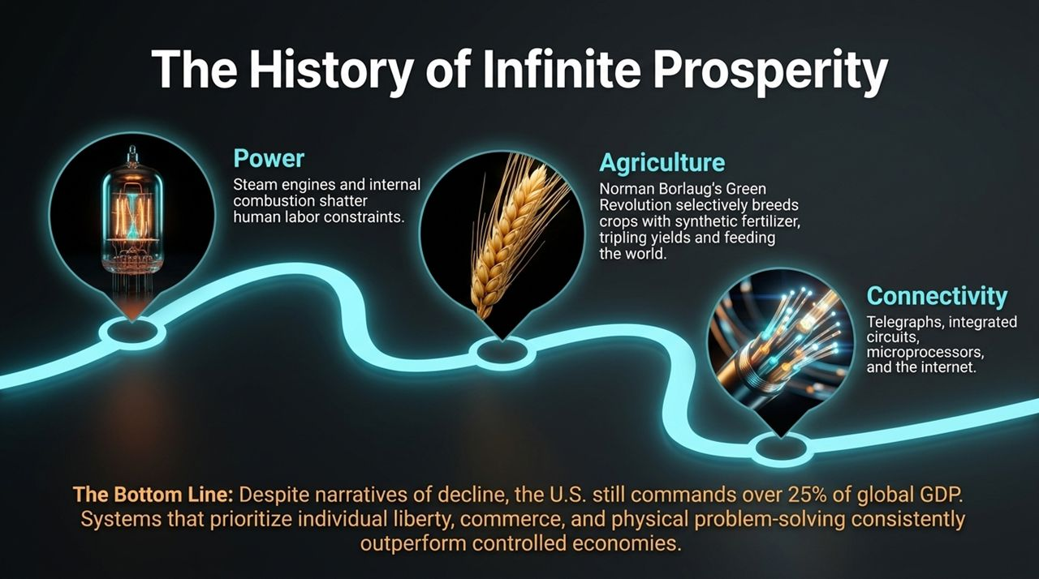
Notes:
Slide 10 provides critical historical context to counter pervasive narratives of civilizational decline[cite: 1, 2]. Despite current institutional challenges, human history demonstrates that technological innovation applied to physical constraints creates compounding prosperity.
Three Waves of Physical Breakthroughs:
Power Generation:
The transition from human and animal muscle power to steam engines and internal combustion engines broke ancient labor constraints. It liberated human societies from universal agrarian subsistence.
Agricultural Revolution:
Norman Borlaug’s "Green Revolution" introduced high-yield crop varieties combined with synthetic nitrogen fertilizers.
This single physical chemistry breakthrough tripled global crop yields and saved over one billion people from mass starvation.
Connectivity & Computation:
From telegraph lines to integrated circuits, microprocessors, fiber optics, and global IP networks, information friction was reduced to near zero.
The Macro Bottom Line:
Despite media narratives of societal decay, the United States still generates approximately 25% of global GDP with only 4% of the world's population.
Economic systems rooted in individual liberty, property rights, open commerce, and physical problem-solving systematically outperform state-controlled or ideologically managed economies.
Human ingenuity, when unimpeded by ideological capture, remains the ultimate renewable resource.

Slide 11
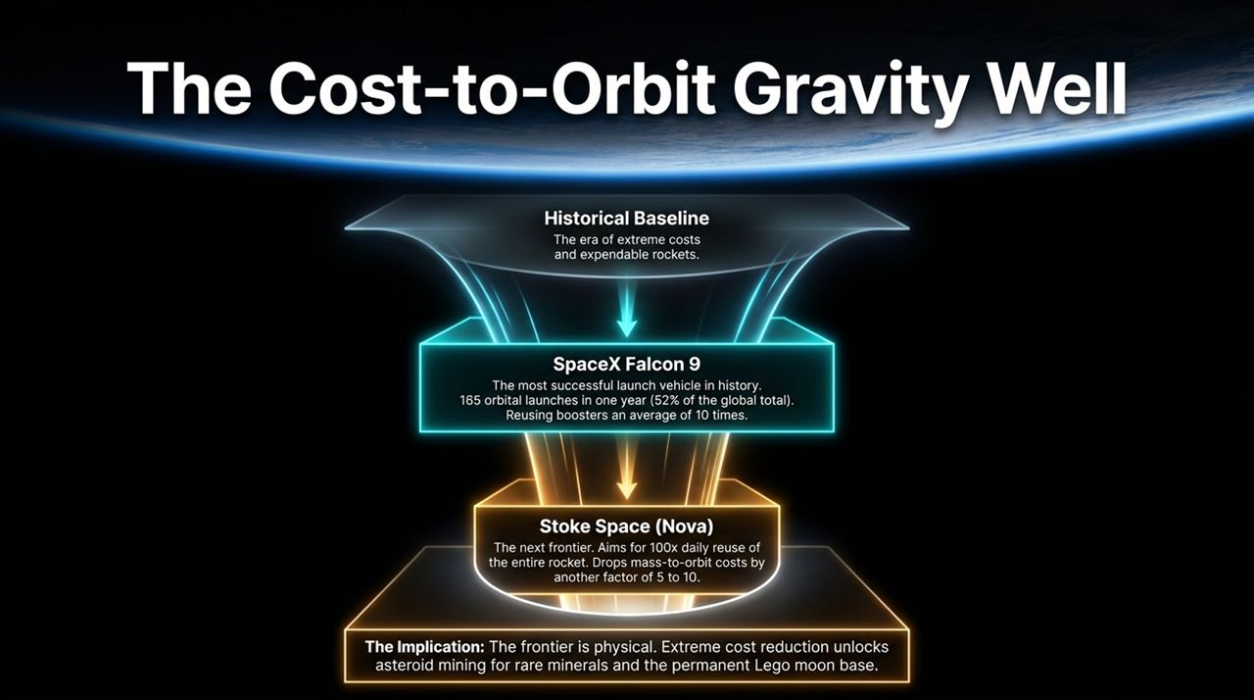
Notes:
Slide 11 illustrates what happens when private enterprise, open competition, and relentless engineering execution break a 50-year state-monopoly bottleneck: The Commercial Space Revolution.
[Historical Baseline: $10,000+/kg] ──> [SpaceX Falcon 9: $1,500/kg] ──> [Stoke Space Nova: Full Reuse]
1. The Historical Baseline (NASA / Legacy Aerospace)
For five decades following the Apollo program, the cost to launch payload into Low Earth Orbit (LEO) remained stuck at $10,000 to $20,000 per kilogram.
Government cost-plus contracts incentivized expendable rockets, bloated supply chains, and zero engineering risk-taking.
2. SpaceX Falcon 9 Transformation
By introducing propulsive booster landing and rapid reuse, SpaceX fundamentally altered space economics.
Data Point: SpaceX conducted 165 orbital launches in a single year, representing over 52% of all global launches. Individual Falcon 9 first-stage boosters are regularly re-flown over 10 to 20 times. Launch costs plummeted to roughly $1,500 per kilogram.
3. The Next Frontier: Full Reuse (Stoke Space & Starship)
Companies like Stoke Space (developing the Nova rocket) and SpaceX (Starship) are targeting second-stage full reusability.
Reusing both the upper stage and booster aims to deliver a 100x reduction in launch costs, bringing cost-to-orbit down toward $100 per kilogram.
4. What Extreme Cost Reduction Unlocks:
When launch costs approach fuel costs, space ceases to be a government research project and becomes an industrial economic zone.
It unlocks asteroid mining for platinum-group metals, orbital manufacturing, deep-space exploration, and permanent lunar infrastructure. Physical engineering breaks the gravity well.

Slide 12
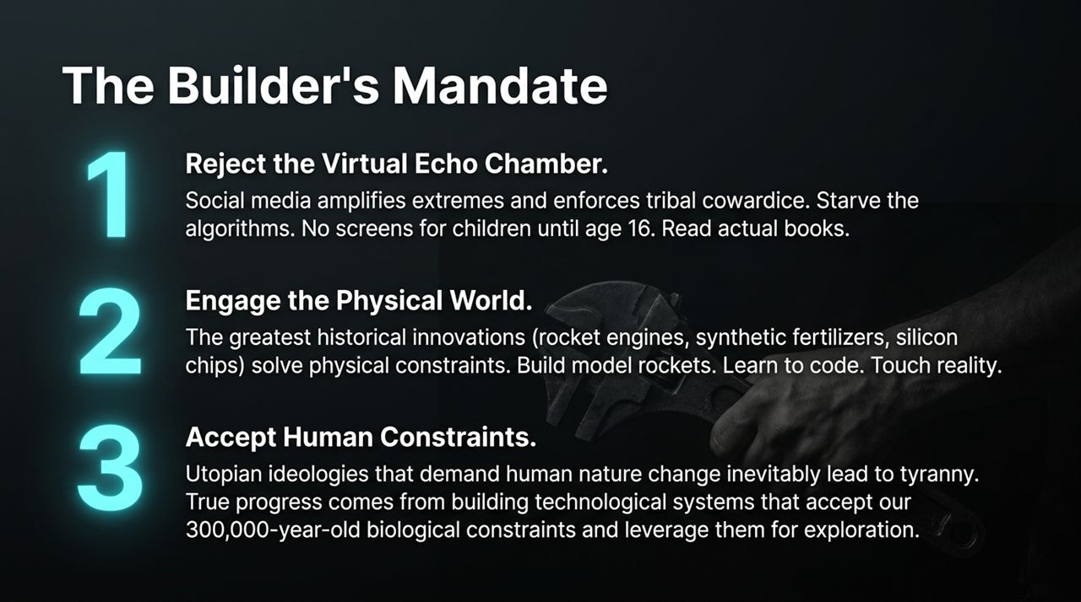
Notes:
Slide 12 outlines Ben Slivka’s practical blueprint for parents, educators, leaders, and the rising generation[cite: 1, 2]. How do we counter ideological capture, digital addiction, and institutional passivity?
[1. Reject Virtual Echo Chamber] ──> [2. Engage Physical World] ──> [3. Accept Human Constraints]
1. Reject the Virtual Echo Chamber
Social media algorithms are designed to monetize tribal outrage, amplify political extremes, and punish nuanced thought. They encourage ideological cowardice.
Actionable Rule: Starve the algorithms. Ben Slivka strongly advocates no smartphones or social media for children until age 16. Replace dopamine-driven screen feeds with long-form reading, physical books, and deep focus.
2. Engage the Physical World
The history of human progress was not written by commentators or social media influencers; it was written by builders who solved physical problems.
Encourage children and young adults to build model rockets, work with machinery, code software applications, draft blueprints, and handle physical materials. Teach them to ground their self-worth in tangible accomplishments rather than virtual validation.
3. Accept Human Constraints
Utopian social projects that demand human biology or basic economics change invariably lead to coercion, institutional rot, and administrative tyranny.
Real progress comes from designing technological, economic, and political systems that accept our 300,000-year-old biological constraints and leverage human nature toward constructive exploration, commerce, and discovery.

Slide 13
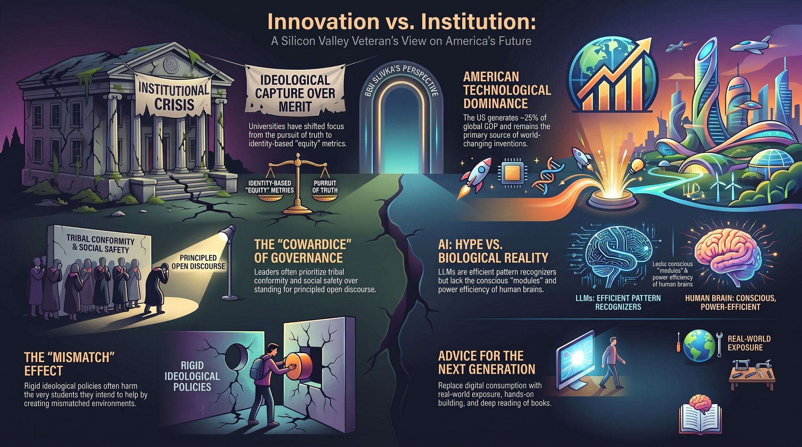
Notes:
Slide 13 brings our analysis together into a single executive dashboard. It contrasts the drivers of civilizational decline against the drivers of American technological leadership.
┌─────────────────────────────────────────────────────────┐
│ INSTITUTIONAL CRISIS │
├────────────────────────────┬────────────────────────────┤
│ Ideological Capture │ The Cowardice Loop │
│ Identity Equity Metrics │ Tribal Conformity │
└────────────────────────────┴────────────────────────────┘
│
▼
┌─────────────────────────────────────────────────────────┐
│ AMERICAN INNOVATION FUTURE │
├────────────────────────────┬────────────────────────────┤
│ Puruit of Truth │ Physical Engineering │
│ Energy & Space Scale │ Real-World Building │
└────────────────────────────┴────────────────────────────┘
Core Themes Summary:
Institutional Crisis vs. Pursuit of Truth:
Higher education and legacy institutions have compromised their primary mission by replacing meritocracy and open debate with administrative safety and identity-based equity metrics[cite: 1, 2].
The Governance of Cowardice:
Leadership failures occur when trustees, CEOs, and university leaders choose quiet compliance over principled defense of free inquiry and due process[cite: 1, 2].
AI Realism vs. Biological Reality:
Large Language Models are sophisticated pattern matchers, not conscious entities. True intelligence is grounded in energy-efficient biological architecture and real-world interactions.
The Physical Bottleneck:
America cannot remain a superpower through virtual software alone. We must dismantle regulatory barriers to build nuclear power plants, energy grids, and space transport systems.
The Next Generation Mandate:
Disconnect from algorithmically driven outrage, cultivate real-world technical skills, read deeply, and build systems that respect physical reality.
Thank you. I am happy to open the floor to questions and discussion[cite: 1, 2].
Ben Slivka Predicted the Internet Era. He Doesn't Buy the Hype About AI.
https://www.youtube.com/watch?v=xghaeBHamYs

